Slide 1
Computer Architecture
Dr. Mervat M. A. Mahmoud
Reference:
- William sterling , “computer organization and architecture”, 8th edition.
Computer Architecture Module Content
Central Processing Unit Architecture
  Design Approaches [Stack – Pipelining – Interrupt – Processor Organization
– Registers Organization]
  Instruction Set Architecture [Instruction Format – Addressing modes –
Data Transfer and Manipulation]
  Example architectures (e.g. CISC, RISC)
Timing, Clock Parameters, and Processor Performance
Memory Hierarchy
  Main Memory
  Cache Memory
  Virtual Memory
2

Slide 2
Processor Performance
Reference:
- William sterling, “computer organization and architecture”, chapter 2
3
Processor Performance
Year by year,
  The cost of computer systems continues to drop dramatically,
  The performance and capacity of those systems continue to rise equally dramatically.
    That enables the development of applications of amazing complexity and power.
Workstation systems now support
Highly sophisticated engineering and scientific applications
Simulation systems
Image and video applications
Servers handle the transaction and database processing and support massive client/server networks

Slide 3
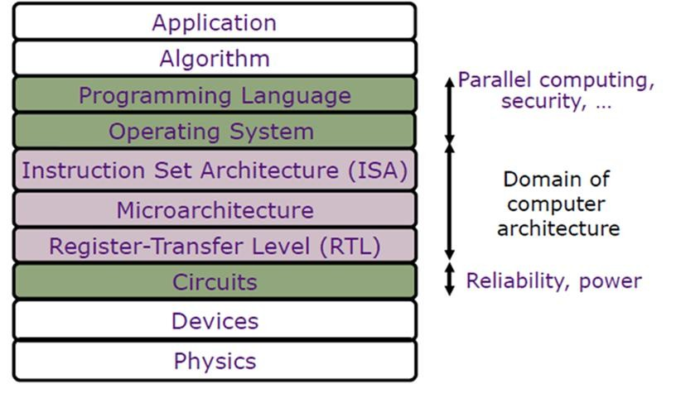
Processor Performance
However,
  From the perspective of computer organization and architecture, the basic building blocks for today’s computer miracles are virtually the same as those of computers from over 60 years ago
  On the other hand, the techniques out of the materials at hand have become increasingly sophisticated.
How to change performance at different
abstraction layers
6

Slide 4
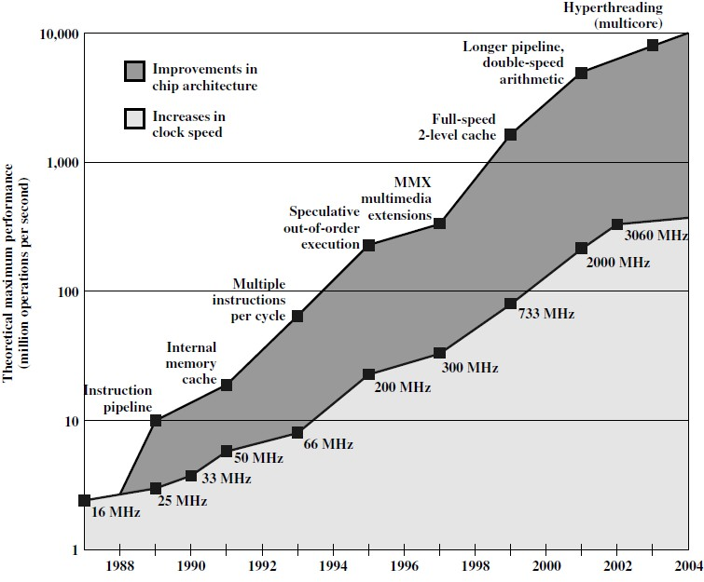
Intel Microprocessor Performance
Increase the clock speed: the on-chip increase of logic density
Improvement of processor architecture
Hardware Technology is the dominant factor
in computer design:
Transistors
Memories: ROMs, RAMs
Packaging
6

Slide 5
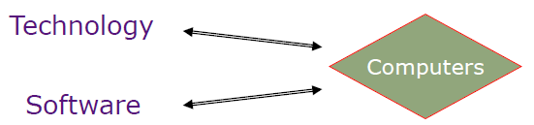
But Software...
As people write programs and use computers, our understanding of programming and program behavior improves.
Modern architects pay attention to the software and compilation issues.
Software also can affect speed and power.
9
Processor Performance Metrics
Speed (Frequency)
Size (Area)
Cost
Power dissipation
Energy dissipation for portable devices
Security, … etc. according to application

Slide 6
Processor Performance Metrics
The dominant factors in performance are the clock speed and logic density.
logic density increase, a number of obstacles become more significant
Power: As the density of logic and the clock speed on a chip increase, so does the power density (Watts/cm2). The difficulty of dissipating the heat generated on high-density, high-speed chips is becoming a serious design issue.
Interconnect delay: As components on the chip decrease in size (Transistor size reaches 9nm), the wire interconnect delay become a serious design issue.
Crosstalk: the unwanted coupling between signal paths. as the wires are closer together.
Designing for Performance
The raw Speed of the microprocessor will not achieve its potential unless it is fed a constant stream of work to do in the form of computer instructions.
Anything that gets in the way of that smooth flow reduces the processor’s speed.
The driving factors behind the Microprocessor Speed
Chip Organization and Architecture Branch instructions
Memory latency: Memory speeds lag processor speed. Data flow between memory systems (memory hierarchy) I/O data rates
Notes:
1. Why Increasing Logic Density Improves Performance
Logic density refers to the number of transistors per unit area (e.g., transistors/cm²).
When logic density increases:
More transistors can be integrated on one chip.
More functional units (ALUs, caches, cores) can be added.
The processor can execute more operations in parallel.
Higher clock speeds can be achieved (shorter transistor switching times).
Therefore, higher logic density generally leads to higher computational performance.
2. Major Obstacles with Increasing Logic Density
As logic density and clock speed increase, three major challenges appear:
(a) Power Density
Power density = Power per unit area (Watts/cm²)
When:
Transistor count increases
Clock frequency increases
Power consumption increases significantly.
This causes:
Excessive heat generation
Thermal management problems
Reliability degradation
Possible chip failure
Heat removal becomes one of the biggest design challenges in modern processors.
(b) Interconnect Delay
In modern technologies (e.g., 9 nm):
Transistors are extremely small.
Wires (interconnects) become thinner and closer together.
Although transistor switching becomes faster, wire delay does not scale down at the same rate.
Interconnect delay depends on:
$$Delay∝R×C$$
Where:
R = resistance of wire
C = capacitance between wires
As wires become thinner:
Resistance increases
Capacitance between nearby wires increases
Result:
Interconnect delay may dominate total chip delay.
(c) Crosstalk
Crosstalk is the unwanted electromagnetic coupling between adjacent signal wires.
As wires get closer:
Electric fields overlap
Signals in one wire induce noise in another
This causes:
Signal integrity problems
Timing errors
Increased power consumption
Possible logic malfunction
Crosstalk becomes more severe in high-frequency and high-density designs.
3. Why Power Density Is Critical at 9 nm
At very small technology nodes:
Billions of transistors are packed in a small area.
Leakage currents increase.
Switching frequency increases.
Power dissipation:
$$P=αCV^{2}f$$
Where:
$f$= frequency
$V$= voltage
$C$= capacitance
As frequency increases → power increases.
As density increases → more total switching activity.
Result:
Very high heat concentration in small silicon area.
Cooling and thermal design become limiting factors in performance scaling.
4. Impact of Interconnect Delay on Performance
Even if transistors switch in picoseconds:
Signals must travel across long on-chip wires.
Wire delay increases with chip size.
Eventually:
Interconnect delay > Gate delay
This means performance is limited not by transistor speed, but by how fast signals move across the chip.
Modern solutions include:
Repeaters (buffers)
Better materials (copper instead of aluminum)
3D stacking
Network-on-chip (NoC)
5. Crosstalk Explanation
Crosstalk occurs when:
A switching signal in one wire induces voltage in an adjacent wire.
This happens due to:
Capacitive coupling
Inductive coupling
Effects:
Noise
Delay variation
Glitches
Incorrect logic values
To reduce crosstalk:
Increase spacing between wires
Shield critical wires
Use lower voltage swings
Better routing techniques
Summary
As logic density increases, performance improves due to more transistors and higher clock speeds. However, three major physical limitations arise:
Power density (thermal problem)
Interconnect delay (RC delay dominance)
Crosstalk (signal integrity problem)
These factors now limit processor scaling more than transistor switching speed.
Question
The raw speed of a microprocessor cannot reach its full potential unless it is continuously supplied with instructions and data.
Explain why a constant stream of instructions is necessary for achieving maximum processor speed.
Discuss the main factors that drive microprocessor speed.
Explain how chip organization and branch instructions affect performance.
What is memory latency, and why does it limit processor performance?
How do I/O data rates influence overall system speed?
Answer
1. Importance of a Constant Instruction Stream
A microprocessor operates at a very high clock speed. However, it can only perform useful work if:
Instructions are continuously available.
Data is supplied without delay.
If the processor must wait for instructions or data:
Pipeline stalls occur.
Functional units remain idle.
Effective performance decreases.
Therefore, the processor’s real speed depends not only on clock frequency but also on how efficiently it is fed with instructions and data.
2. Driving Factors Behind Microprocessor Speed
The main factors that determine processor speed are:
(a) Clock Frequency
Determines how many cycles occur per second.
Higher frequency → more operations per second.
(b) Chip Organization and Architecture
Pipeline depth
Superscalar design
Out-of-order execution
Cache organization
Number of cores
Good architecture increases instruction-level parallelism and throughput.
(c) Branch Instructions
Branches change program flow.
Incorrect branch prediction causes pipeline flushing.
This wastes clock cycles and reduces performance.
3. Effect of Chip Organization and Branch Instructions
Chip Organization
Efficient organization includes:
Pipelining
Multiple execution units
Large and fast caches
Poor organization leads to:
Resource conflicts
Structural hazards
Increased latency
Branch Instructions
Branches introduce control hazards.
When a branch is encountered:
The processor may not know the next instruction.
It must predict the branch direction.
If prediction is wrong:
Pipeline is flushed.
Several cycles are lost.
Frequent branches significantly reduce performance.
4. Memory Latency
Memory latency is the time required to:
Access data from memory.
Deliver it to the processor.
Problem:
Processor speeds increase faster than memory speeds.
This creates a performance gap called the memory wall.
Because of this:
The processor often waits for memory.
Performance is limited by memory access time.
Solution:
Memory hierarchy (Registers → L1 → L2 → L3 → RAM)
Caching
Prefetching
5. I/O Data Rates and System Speed
I/O devices (disk, network, peripherals):
Operate much slower than CPU.
Can become system bottlenecks.
If data transfer rates are slow:
The processor waits for input/output operations.
Overall system performance decreases.
Modern systems use:
DMA (Direct Memory Access)
High-speed buses (PCIe)
Buffering techniques
Conclusion
Microprocessor speed is not determined by clock frequency alone.
Performance depends on:
Efficient chip architecture
Effective branch handling
Low memory latency
High I/O throughput
Any delay in instruction or data flow prevents the processor from achieving its full potential.
If you want, I can now:
Convert this into a short 5–6 mark exam answer
Add diagrams explaining memory hierarchy and branch stalls
Create comparison tables for revision
Give numerical examples related to memory latency
Just tell me what you prefer.

Slide 7
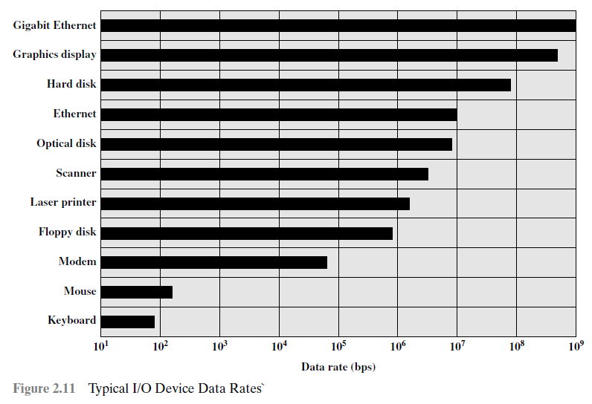
I/O Device Data Rates
As computers become faster and more capable, more sophisticated applications are developed that support the use of peripherals with intensive I/O demands.
  Strategies here include caching and buffering schemes plus the use of higher- speed interconnection buses.
Typical I/O Device Data Rates

Slide 8
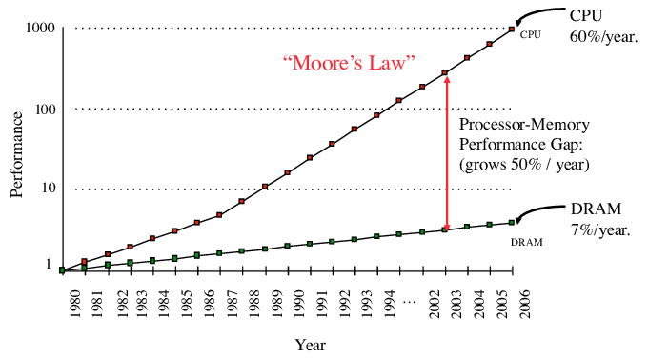
Processor speed vs Memory speed
CPU vs DRAM Performance
Processor speed vs Memory speed
The interface between the processor and main memory is responsible for carrying a constant flow of program instructions and data between memory chips and the processor.
If memory or the pathway fails to keep pace with the processor’s firm demands, the processor stalls in a wait state, and the valuable processing time is lost.
Notes:
🧠 CPU vs DRAM – Why Speed Mismatch Matters
4
The interface between the CPU (processor) and main memory (DRAM) is critical because it continuously transfers:
📥 Program instructions
📤 Data needed for execution
If this pathway is slow, the processor must wait, creating what is called a wait state — meaning the CPU is idle instead of doing useful work.
🔍 What is the CPU?
The CPU (Central Processing Unit):
Executes instructions
Performs calculations
Controls system operations
Works at very high speed (GHz range)
Modern CPUs can process billions of instructions per second.
🔍 What is DRAM?
DRAM (Dynamic Random Access Memory):
Stores program instructions and data temporarily
Slower than CPU
Access time measured in nanoseconds
Needs constant refreshing
Even though DRAM is fast, it is much slower than the CPU.
⚡ The Problem: Speed Gap
ComponentSpeedCPUExtremely fast (GHz)DRAMMuch slower than CPU
This difference is called the Memory Bottleneck.
When:
The CPU requests data
DRAM cannot deliver it quickly enough
➡ The CPU enters a wait state
➡ Processing stops temporarily
➡ Performance decreases
🛠 How Computers Solve This Problem
To reduce CPU waiting:
1️⃣ Cache Memory
Small, very fast memory placed between CPU and DRAM.
Levels:
L1 (fastest, smallest)
L2
L3
Cache stores frequently used data so the CPU doesn't always access DRAM.
2️⃣ Faster Memory Buses
The pathway (bus) between CPU and memory is designed to:
Increase bandwidth
Reduce latency
3️⃣ Advanced Memory Technologies
Modern systems use:
DDR4 / DDR5
Dual-channel memory
Higher clock speeds
📌 Summary
The CPU is much faster than DRAM.
If DRAM or the memory pathway is too slow, the CPU stalls.
This stall is called a wait state.
Cache memory helps reduce this problem.
The CPU vs DRAM speed gap is a major system performance challenge.

Slide 9
Designing for Performance
While the chipmakers have been busy learning how to fabricate chips of greater and greater density, the processor designers must come up with ever more elaborate techniques for feeding the monster.
Some techniques that are built into modern processors:
Branch prediction Data flow analysis Speculative execution Superscalar execution Pipelining
Branch prediction
The processor looks ahead in the instruction code fetched from memory and predicts which branches, or groups of instructions, are likely to be processed next.
If the processor guesses right most of the time, it can prefetch the correct instructions and buffer them so that the processor is kept busy.
Notes:
🔮 1) Branch Prediction
Programs often contain decision instructions like:
if (x > 0)
do A
else
do B
The processor does not want to wait to know which path will be taken.
👉 Branch prediction guesses the correct path in advance.
If the guess is correct → no delay.
If wrong → processor discards work and corrects it (small penalty).
✅ Reduces waiting time
✅ Keeps pipeline full
🔄 2) Data Flow Analysis
The processor analyzes:
Which instructions depend on previous results
Which instructions are independent
👉 Independent instructions can be executed out of order.
Example:
A = B + C
D = E + F
These two can run at the same time because they don’t depend on each other.
✅ Improves parallel execution
✅ Increases CPU efficiency
🚀 3) Speculative Execution
4
The processor executes instructions before it is 100% sure they are needed.
It “speculates” based on branch prediction.
If prediction is correct → results are kept.
If wrong → results are discarded.
✅ Saves time
⚠️ Uses extra power
⚠️ Can cause security risks (e.g., Spectre-type attacks)
⚡ 4) Superscalar Execution
A superscalar processor has:
Multiple ALUs (Arithmetic Logic Units)
Multiple execution units
👉 It can execute more than one instruction per clock cycle.
Instead of:
1 instruction per cycle
It can do:
2, 4, or more per cycle
✅ Increases throughput dramatically
🔁 5) Pipelining
4
Pipelining divides instruction execution into stages:
Fetch
Decode
Execute
Memory
Write-back
Like an assembly line in a factory.
While one instruction is executing,
another is decoding,
another is being fetched.
✅ Multiple instructions processed simultaneously
✅ Greatly improves performance
📌 Why All These Techniques Exist
Because:
CPUs are extremely fast
Memory is slower
Waiting wastes processing power
So modern processors use:
Branch prediction
Data flow analysis
Speculative execution
Superscalar execution
Pipelining
👉 All to keep the CPU busy and avoid stalls.
If you want, I can also give you:
✍️ A short exam-ready summary paragraph
📊 A comparison table
🧠 A simplified explanation for beginners

Slide 10
Data flow analysis
The processor analyzes which instructions are dependent on each other’s results, or data, to create an optimized schedule of instructions.
In fact, instructions are scheduled to be executed when ready, independent of the original program order. This prevents unnecessary delay.
Speculative execution
Type of parallelism form
Using branch prediction and data flow analysis, some processors speculatively execute instructions ahead of their actual appearance in the program execution, holding the results in temporary locations.
This enables the processor to keep its execution engines as busy as possible by executing instructions that are likely to be needed.

Slide 11
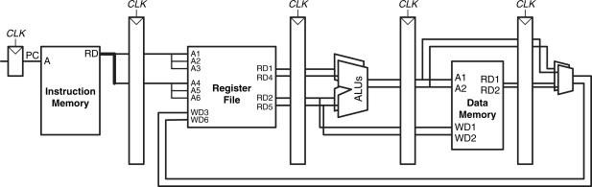
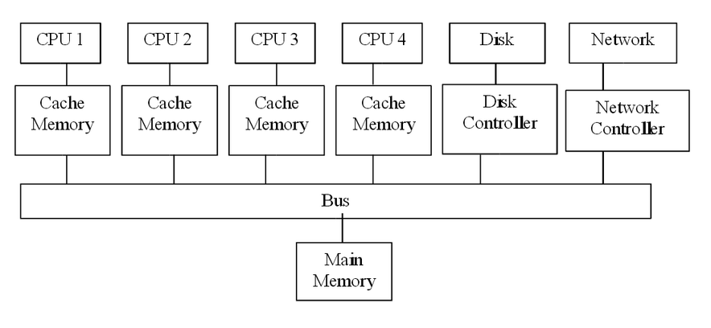
Superscalar execution
A superscalar processor can execute more than one instruction during a clock cycle by simultaneously sending multiple instructions to different execution units to the processor.
Multicore Processor Example

Slide 12
Intel Microprocessor Performance
Two main strategies have been used to increase performance:
First, there has been an increase in cache capacity. There are now typically two or three levels of cache between the processor and main memory. As chip density has increased, more of the cache memory has been incorporated into the chip, enabling faster cache access.
  For example, the original Pentium chip devoted about 10% of the chip area to a cache. The Pentium 4 chip devotes about 50% of the chip area to caches.
Second, the instruction execution logic within a processor has become increasingly complex to enable parallel execution of instructions within the processor.
  Pipelining approach enables different stages of execution of different instructions at the same time.
  Superscalar approach allows multiple pipelines within a single processor so that instructions that do not depend on one another can be executed in parallel.
Intel Microprocessor Performance
In 2003, designers turned to a fundamentally new approach to improve the performance: placing multiple processors on the same chip, with a large shared cache.
  The multicore provides the potential to increase performance without increasing the clock rate. But if the software can support the effective use of multiple processors, then doubling the number of processors almost doubles performance. Thus, the strategy is to use two simpler processors on the chip rather than one more complex processor.
  In addition, with two processors, larger caches are justified. This is important because the power consumption of memory logic on a chip is much less than that of processing logic.
Notes:
🚀 Two Main Strategies to Increase CPU Performance
🧠 1️⃣ Increase Cache Capacity
🔹 What Happened?
As chip technology improved (higher transistor density):
More cache memory was added.
Cache was placed inside the processor chip.
Systems now typically use:
L1 Cache
L2 Cache
L3 Cache
🔹 Why Is This Important?
Cache is:
Much faster than DRAM
Closer to the CPU
Reduces wait states
More cache → fewer memory accesses → less stalling → higher performance.
🔹 Example from the Text
Original Pentium: ~10% of chip area = cache
Pentium 4: ~50% of chip area = cache
This shows how important cache became for performance.
⚙️ 2️⃣ More Complex Instruction Execution Logic
The second strategy focuses on making the CPU execute multiple instructions at the same time.
This is called Instruction-Level Parallelism (ILP).
Two major techniques:
🔁 A) Pipelining
🔹 Idea:
Divide instruction execution into stages:
Fetch
Decode
Execute
Memory
Write Back
Instead of finishing one instruction before starting another:
👉 Different instructions are processed at different stages simultaneously.
Like a factory assembly line.
✅ Result:
Higher throughput (more instructions completed per second)
⚡ B) Superscalar Execution
🔹 Idea:
Have multiple pipelines inside one processor.
If instructions do not depend on each other:
👉 They can execute in parallel.
Example:
A = B + C
D = E + F
These two can run at the same time.
✅ Result:
Multiple instructions per clock cycle
Higher overall performance
📊 Final Summary Table
StrategyMethodGoalIncrease CacheLarger, multi-level cache (L1, L2, L3)Reduce memory delayIncrease ParallelismPipeliningOverlap instruction stagesIncrease ParallelismSuperscalarExecute multiple instructions at once
🎯 Overall Idea
Performance improved by:
1️⃣ Reducing memory bottleneck (bigger/faster cache)
2️⃣ Increasing internal parallel execution (pipeline + superscalar)
Modern processors use both strategies together.
If you'd like, I can also give you:
✍️ A short exam-ready paragraph
📘 A simplified version for quick revision
📈 A comparison between pipelining and superscalar only

Slide 13
Evolution of the intel x-86 CISC architecture
8080: The world’s first general-purpose microprocessor. This was an 8-bit machine, with an 8-bit data path to memory.
8086: A 16-bit machine. In addition to a wider data path and larger registers, the 8086 sported an instruction cache, that pre-fetches a few instructions before they are executed.
80286: This extension of the 8086 enabled addressing a 16-MByte memory instead of just 1 MByte.
80386: Intel’s first 32-bit machine, and a major overhaul of the product. This was the first Intel processor to support multitasking, meaning it could run multiple programs at the same time.
Evolution of the intel x-86 CISC architecture
80486: The 80486 introduced the use of much more sophisticated and powerful cache technology and sophisticated instruction pipelining. The 80486 also offered a built-in math coprocessor, offloading complex math operations from the main CPU.
Pentium: With the Pentium, Intel introduced the use of superscalar techniques, which allow multiple instructions to execute in parallel.
Pentium Pro: The Pentium Pro continued the move into superscalar organization begun with the Pentium, with aggressive use of branch prediction, data flow analysis, and speculative execution.
Pentium II: The Pentium II incorporated Intel MMX technology, which is designed specifically to process video, audio, and graphics data efficiently.
Pentium III: The Pentium III incorporates additional floating-point instructions to support 3D graphics software.

Slide 14
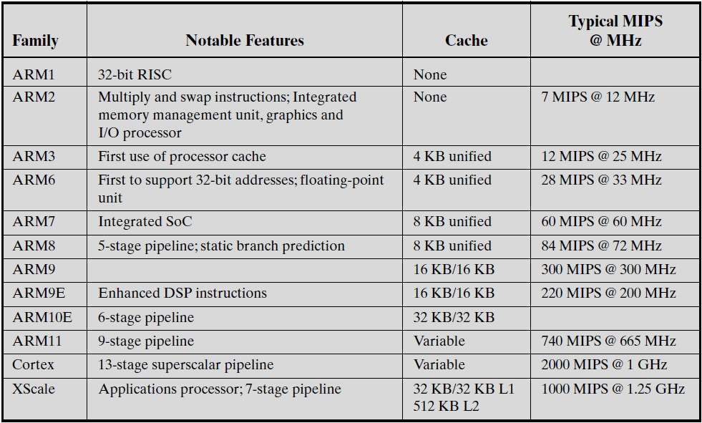
Evolution of the intel x-86 CISC architecture
Pentium 4: The Pentium 4 includes additional floating-point and other enhancements for
multimedia.
Core: This is the first Intel x86 microprocessor with a dual core, referring to the
implementation of two processors on a single chip.
Core 2: extends the architecture to 64 bits. The Core 2 Quad provides four processors on a single chip.
Core 5: six cores and eight threads.
Core 9: eight cores and sixteen threads.
  Multithreading aims to increase utilization of a single core by using thread-level parallelism, as well as instruction-level parallelism.
ARM processor (RISC) Evolution
for Embedded Systems

Slide 15
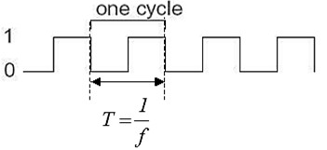
Performance Assessment
29
Performance Assessment
System Clock
Operations, such as fetching an instruction, decoding the instruction, performing an arithmetic operation, and so on, are performed at a system clock.
Typically, all operations begin with the pulse of the clock.
The speed of a processor is measured by the frequency produced by the clock, measured in cycles per second, or Hertz (Hz).
𝒇 =
𝟏
𝒄𝒚𝒄𝒍𝒆 𝒕𝒊𝒎𝒆
=
𝟏
^{𝑻}𝒄𝒍𝒌
= clock rate = clock speed

Slide 16
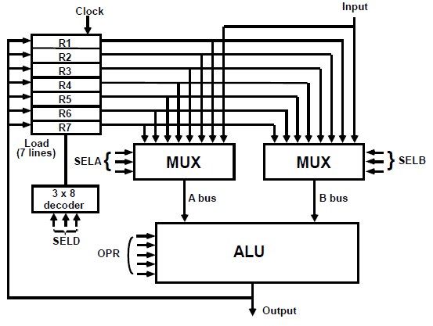
How does design affect CPU performance (frequency/clock cycle)
Propagation delay times: 30 ns for multiplexers,
80 ns for the ADD operation in the ALU, 20 ns for the decoder,
10 ns to clock the data into the register. What is the minimum clock cycle period?
10
30
20
Sol:
30 + 80 + 10 = 120 n sec= min clock cycle
→ max. Frequency = 1 / min. clock cycle
80
Performance Assessment
Average Cycles Per Instruction CPI
  If all instructions required the same number of clock cycles, then CPI would be a constant value for a processor.
  If the number of clock cycles required varies for different types of instructions, such as load, store, branch, etc.
_{σ}𝒏
(𝑪𝑷𝑰_{𝒊} × 𝑰_{𝒊})
𝑰_{𝒄}
𝑪𝑷𝑰 =
𝒊=𝟏
Where 𝑪𝑷𝑰_{𝒊} = the number of cycles required for instruction type i.
𝑰_{𝒊} = the number of executed instructions of type i.
𝑰_{𝒄} = the instruction count for a program or for some defined time interval.

Slide 17
Performance Assessment
Execution Time
  The processor time needed to execute a given program is expressed as
Execution time = 𝑰_{𝒄} × 𝑪𝑷𝑰 × 𝑻_{𝒄𝒍𝒌}
Performance Assessment
MIPS Rate
  The rate at which instructions are executed, expressed as
millions of instructions per second (MIPS)
𝑴𝑰𝑷𝑺 𝒓𝒂𝒕𝒆 =
𝑰_{𝒄} 𝒇
=
𝑬𝒙𝒆𝒄𝒖𝒕𝒊𝒐𝒏 𝒕𝒊𝒎𝒆 × 𝟏𝟎^{𝟔} 𝑪𝑷𝑰 × 𝟏𝟎^{𝟔}
To convert 𝐼_{𝑐} to be in mega, we divided the equation by 10⁶

Slide 18
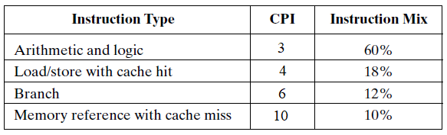
Performance Assessment (Example)
consider the execution of a program which results in the execution of 2 million instructions on a 400-MHz processor. The program consists of four major types of instructions. The instruction mix and the CPI for each instruction type are given below based on the result of a program trace experiment
average CPI = (3 × 0.6) + (4 × 0.18) + (6 × 0.12) + (10 × 0.1) = 4.24
MIPS rate = (400 × 10⁶) / (4.24 ×10⁶) ≈ 94
program execution time = (2 × 10⁶ × 4.24) / (400 × 10⁶) = 21.2 ms
Benchmarks
1. Because of the differences in the instruction sets, the instruction execution rate (MIPS) is not a valid for comparing the performance of different architectures.

Slide 19
Benchmarks
With a CISC machine, this instruction can be compiled into one processor instruction: Add mem(B), mem(C), mem (A)
On a RISC machine, the compilation would look something like this: Load mem(B), reg(1);
Load mem(C), reg(2);
Add reg(1), reg(2), reg(3); Store reg(3), mem (A)
❑ For example, consider this high-level language statement:
A = B + C /* assume all quantities in main memory */
The CISC machine is rated at 1 MIPS, and the RISC machine would be rated at 3 MIPS.
But both do the same amount of high-level language work in around the same amount of time.
Benchmarks
Because of the differences in the instruction sets, the instruction execution rate (MIPS) is not a valid for comparing the performance of different architectures.
The performance of a given processor on a given program may not be useful in determining how that processor will perform on a very different type of application.
  Accordingly, beginning in the late 1980s and early 1990s, industry and academic interest shifted to measuring the performance of systems using a set of benchmark programs. The same set of programs can be run on different machines and the execution times compared.

Slide 20
Benchmarks
A benchmark is a collection of programs, defined in a high-level language, that together attempt to provide a representative test of a computer in a particular application or system programming area.
The best known such collection of benchmark suites is defined and maintained by the System Performance Evaluation Corporation (SPEC), an industry association.
Benchmarks Performance Metrics
Speed up: computer system designers look for ways to improve performance by improvement in technology or change in design. [e.g. parallel processors, memory cache hierarchy].
Speedup evaluate any technical improvement in a computer system.
𝑬𝒙𝒆𝒄𝒖𝒕𝒊𝒐𝒏 𝒕𝒊𝒎𝒆 𝒃𝒆𝒇𝒐𝒓𝒆 𝒆𝒏𝒉𝒂𝒏𝒄𝒆𝒎𝒆𝒏𝒕
𝐒𝐩𝐞𝐞𝐝𝐮𝐩 =
𝑬𝒙𝒆𝒄𝒖𝒕𝒊𝒐𝒏 𝒕𝒊𝒎𝒆 𝒂𝒇𝒕𝒆𝒓 𝒆𝒏𝒉𝒂𝒏𝒄𝒆𝒎𝒆𝒏𝒕
𝑷𝒆𝒓𝒇𝒐𝒓𝒎𝒂𝒏𝒄𝒆 𝒂𝒇𝒕𝒆𝒓 𝒆𝒏𝒉𝒂𝒏𝒄𝒆𝒎𝒆𝒏𝒕
=
𝑷𝒆𝒓𝒇𝒐𝒓𝒎𝒂𝒏𝒄𝒆 𝒃𝒆𝒇𝒐𝒓𝒆 𝒆𝒏𝒉𝒂𝒏𝒄𝒆𝒎𝒆𝒏𝒕

